Slide 1

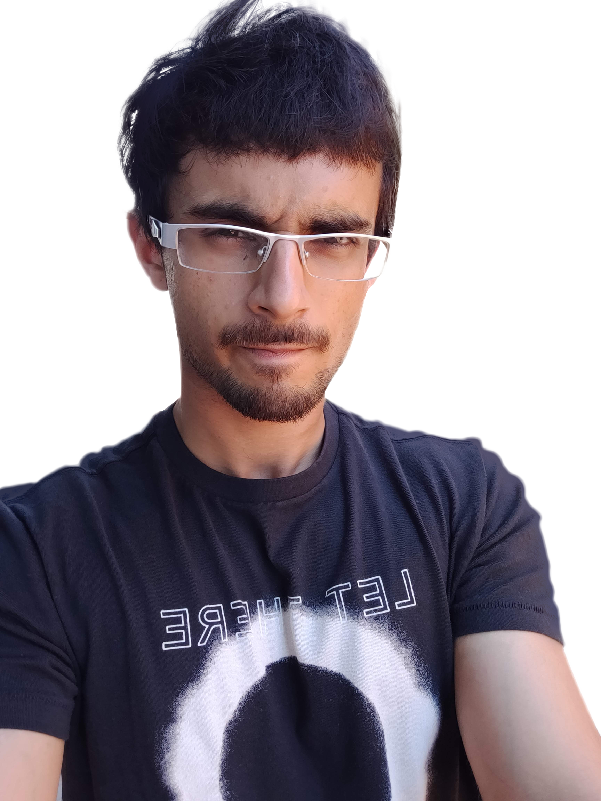
Siddhesh Karekar
INF 555 Assignment
Persona creation, user stories/scenarios,
use cases, and feature list

Slide 2
Persona Hypothesis
(a) What different sorts of people might use this product?
Volunteers – 1 Plastic Life needs volunteers to assist on cleaning drives, build the ‘Precious Plastic’ machines that recycle plastic, and spread awareness
Donators – Contributions help 1 Plastic Life achieve their goal.
2

Slide 3
Persona Hypothesis
(b) How might their needs and behaviors vary?
Donators can be from anywhere around the world
Volunteers must be based around LA
Some volunteers may require certain skills to help achieve 1 Plastic Life goal’s effectively
Volunteers can also help by establishing a partnership with 1 Plastic Life for their business or organization
3

Slide 4
Persona Hypothesis
(c) What ranges of behaviors and types of environments need to be explored?
Volunteers:
Time spent volunteering (few hours a week – few days a week)
Skill in building machines (no skill – highly skilled)
Donators:
Amount donated
Frequency of donation (one time only – recurring)
Kind of help offered (monetary, parts, contacts or networking help)
4

Slide 5
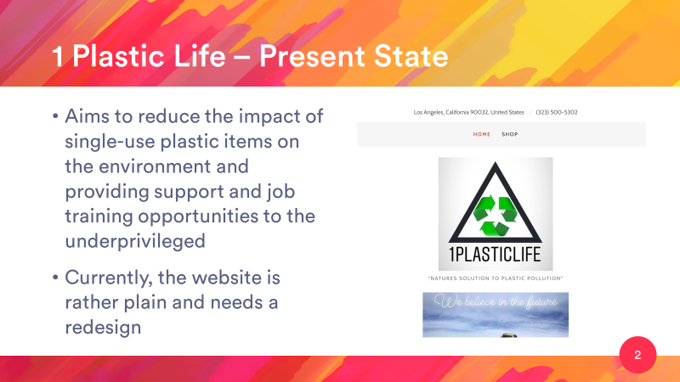
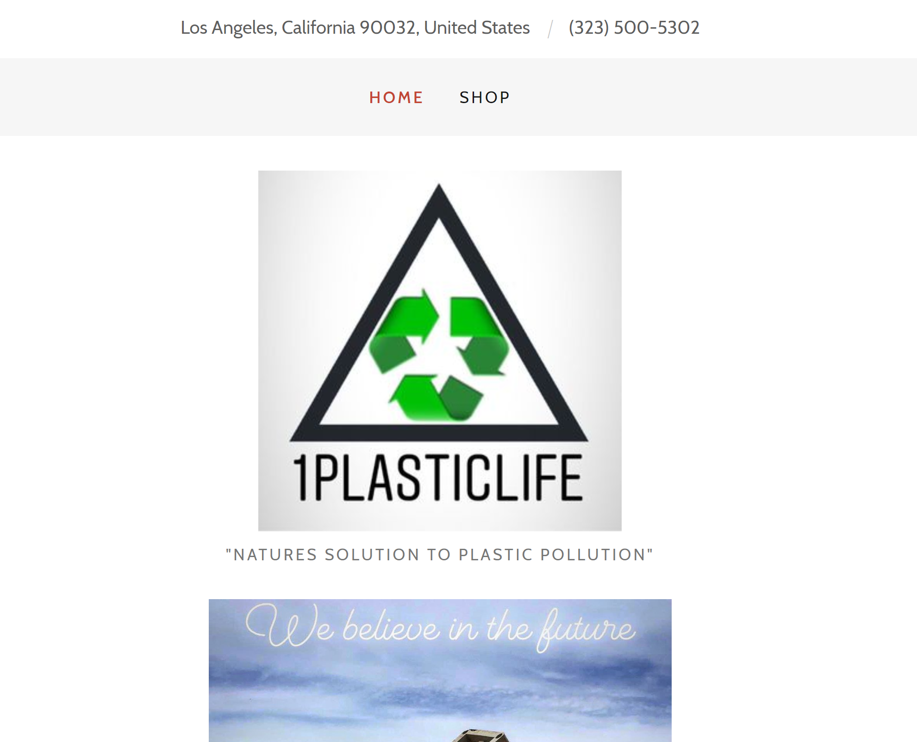
1 Plastic Life – Present State
Aims to reduce the impact of single-use plastic items on the environment and providing support and job training opportunities to the underprivileged
Currently, the website is rather plain and needs a redesign
5

Slide 6

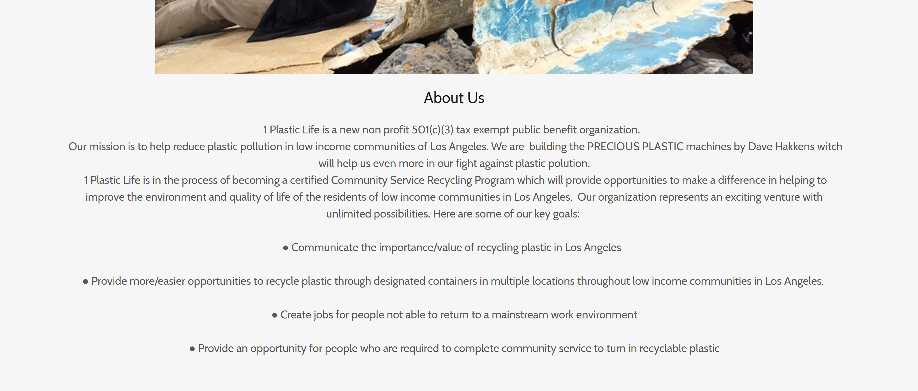
Solution Concept – Before
1 Plastic Life looks rather mundane and plain right now
6

Slide 7
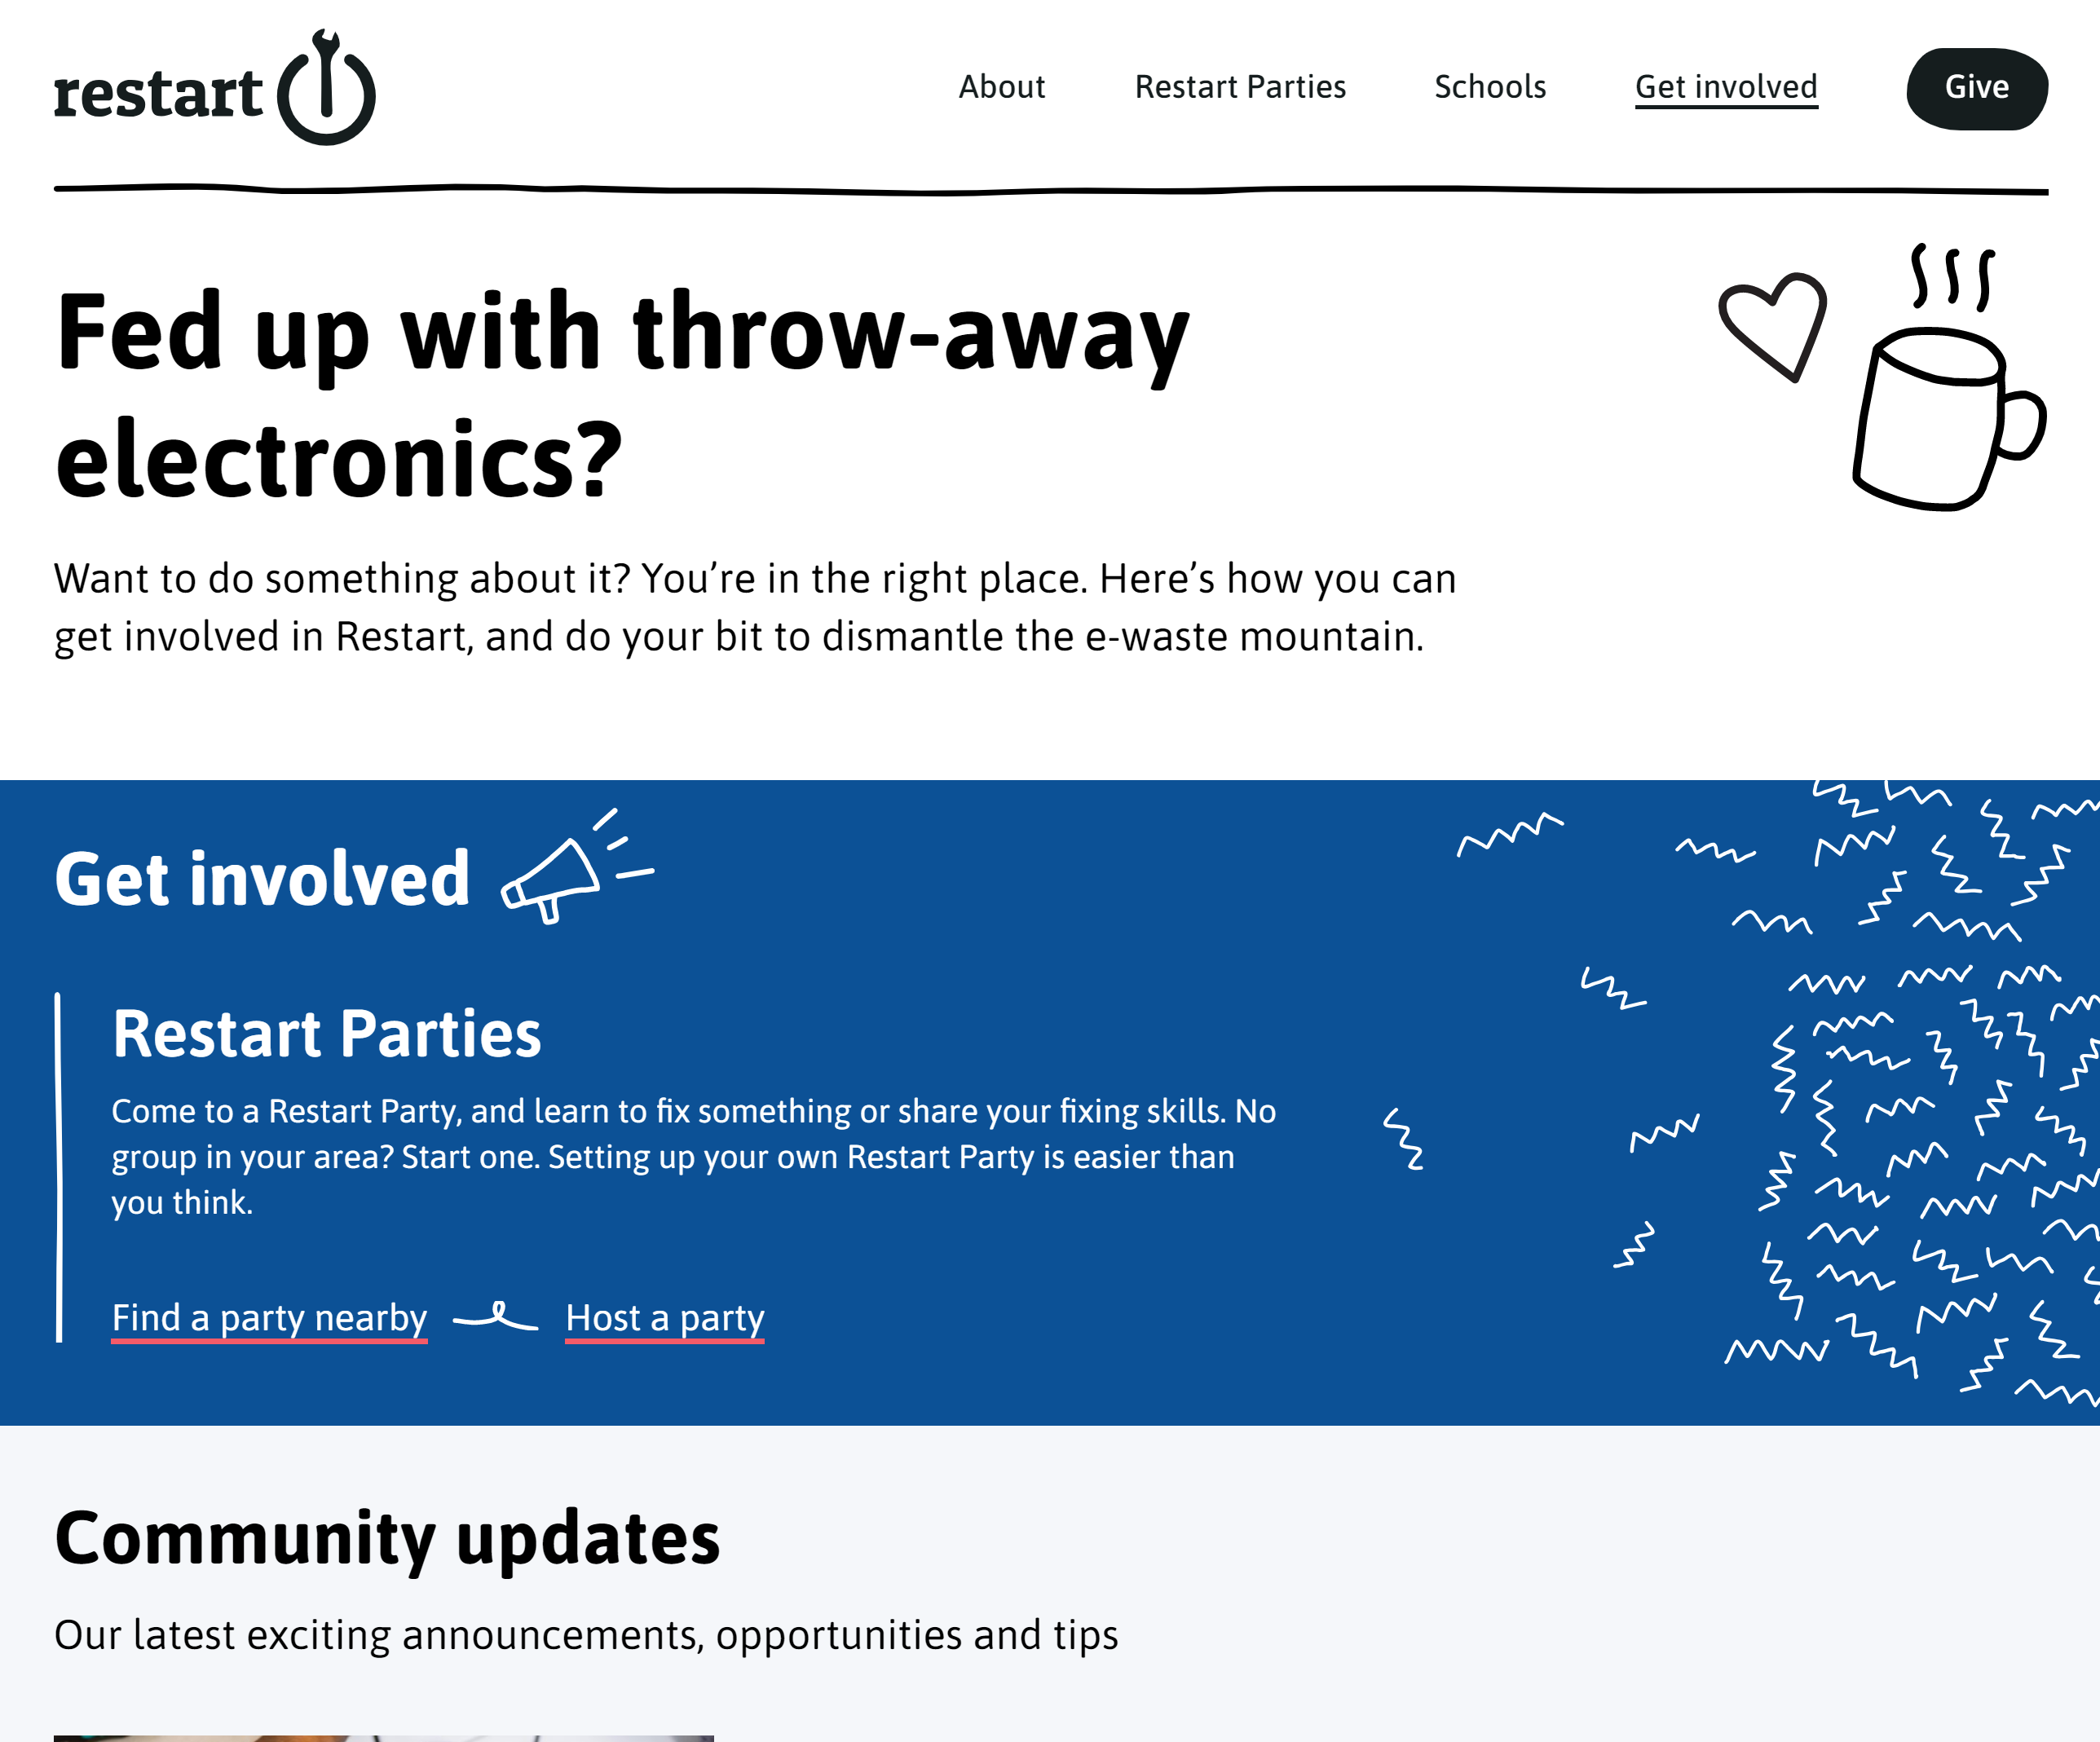
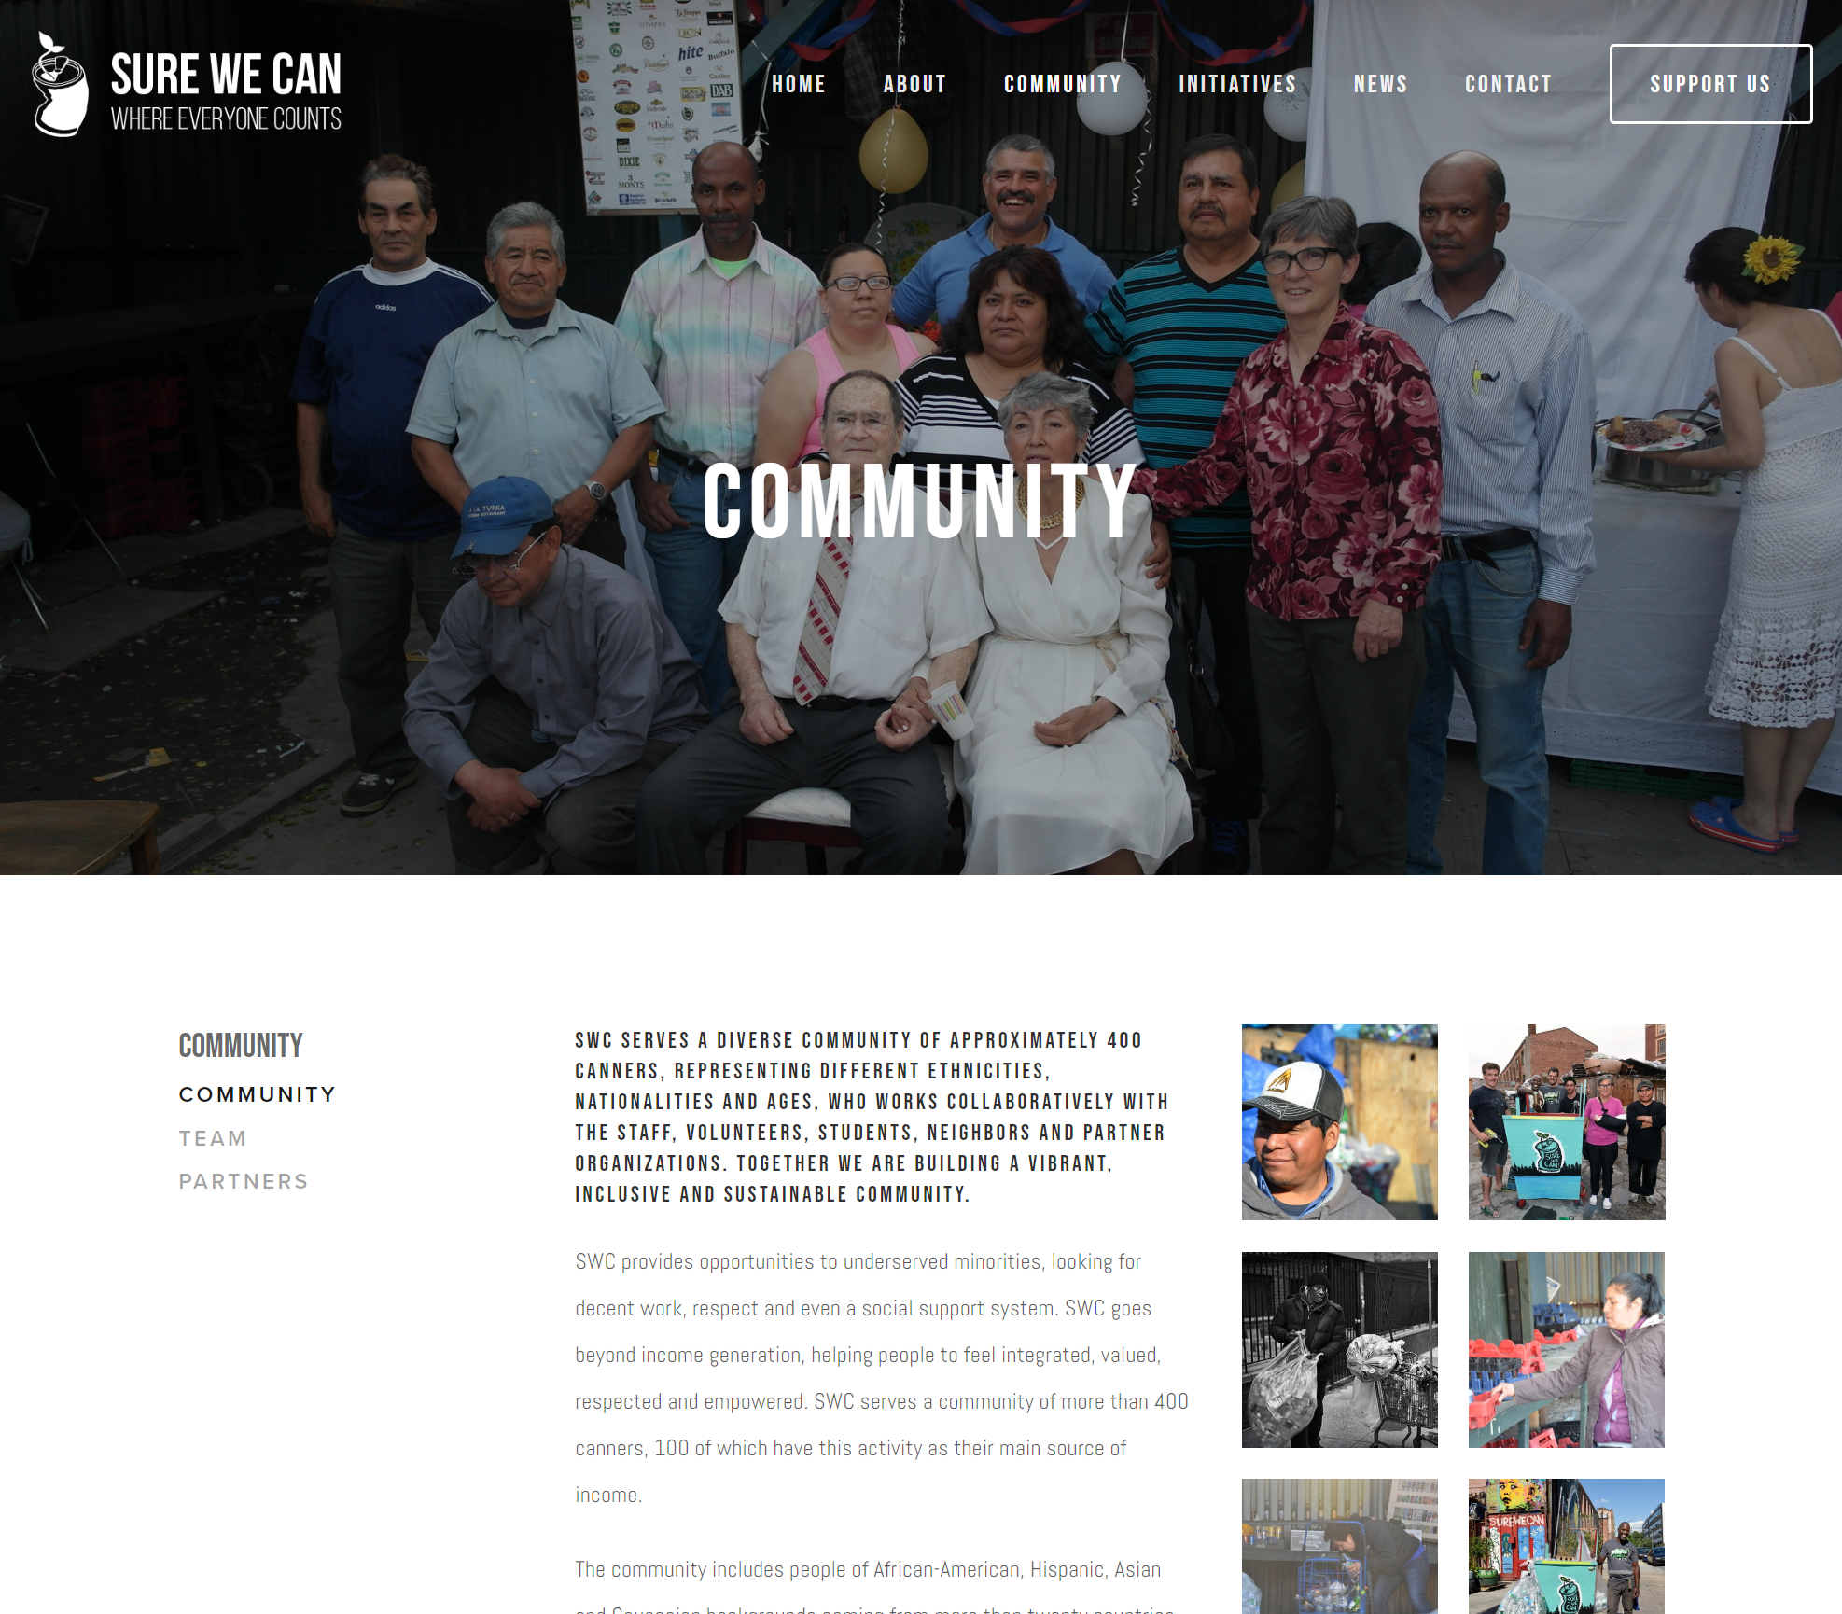
Solution Concept – After
Restart has a clean doodle-like interface to let donators and volunteers help recycle e-waste
Sure We Can, a plastic recycling center, keeps similar functions minimal and organized in columns
7

Slide 8

User Interviews - Donator
What appeals to you most about the cause?
How much are you willing to donate?
How frequently can you donate? Would you prefer smaller recurring amounts or larger occasional amounts?
What kind of resources can you provide, apart from money?
Are there any other causes you support?
What are your expectations from the organization? Do you have any suggestions for us?
8

Slide 9

Primary Persona: Ivan
Donator
Ivan is the Director at a company that works with hardware technology
He prefers to make smaller but frequently recurring donations
He is interested in the different initiatives 1PL undertakes and how they spend his money
He is excited to buy products that 1PL makes with recycled plastic
He spreads the word, hoping to enjoy a clean and plastic-free environment in the future
9

Slide 10
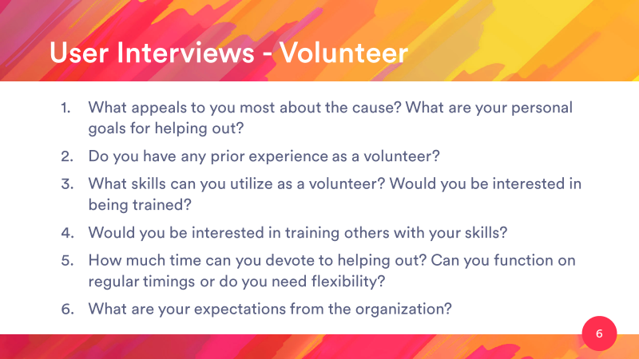
User Interviews - Volunteer
What appeals to you most about the cause? What are your personal goals for helping out?
Do you have any prior experience as a volunteer?
What skills can you utilize as a volunteer? Would you be interested in being trained?
Would you be interested in training others with your skills?
How much time can you devote to helping out? Can you function on regular timings or do you need flexibility?
What are your expectations from the organization?
10

Slide 11
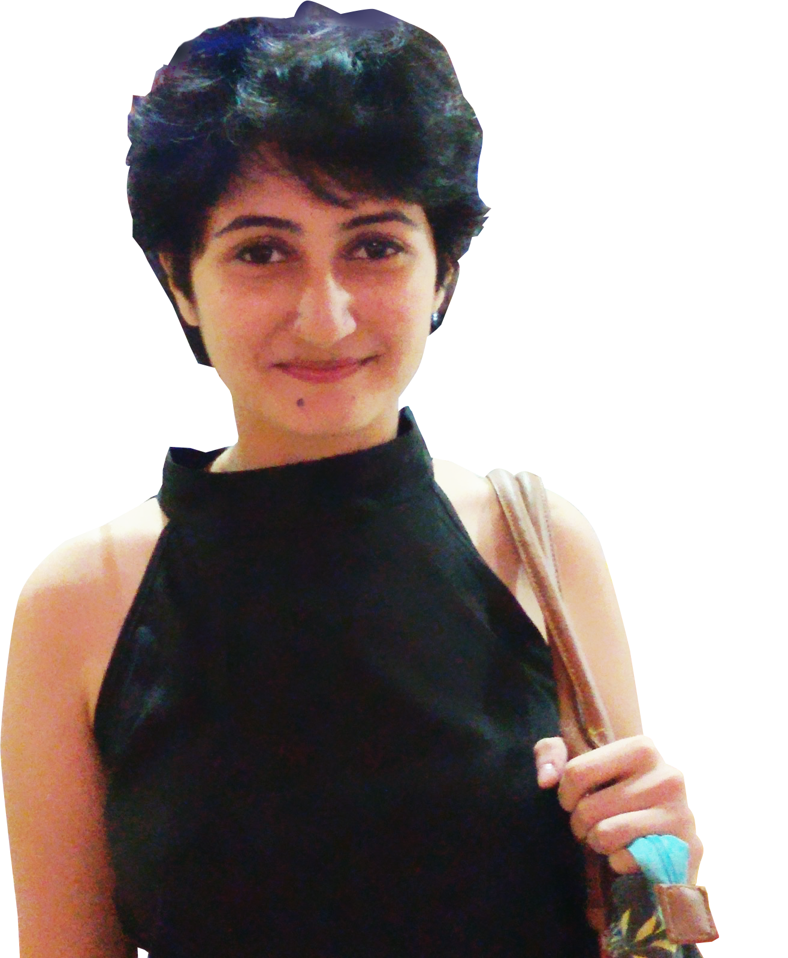
Monica Lorenzo
Volunteer
Monica, is a student and part-time translator who is well aware of the problems of plastic pollution, especially in a city like LA
Due to her busy schedule, she can offer a few hours on the weekends
She is also skilled at graphic design and can make and help make promotional art
She wishes to spread awareness and create a cleaner place for everyone to live in
She would like to see, buy and gift interesting things created from recycled plastic
11

Slide 12
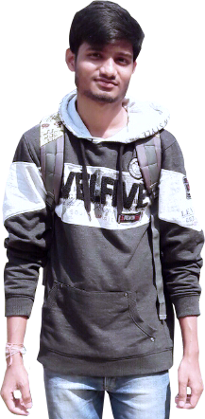
Suraj Gupta
Volunteer
Suraj works with his father in a convenience store
He knows that plastic is a real problem that causes the death of fish and sea turtles
He tries to avoid using plastic in his store, e.g. using cloth bags even though they are more expensive
He would be able to help out on the weekends or on days that the shop is shut, for a few hours
He doesn’t have any prior volunteer experience but would be eager to help
He carries useful general goods and equipment, and his father might also have connections that might help procure more
12

Slide 13
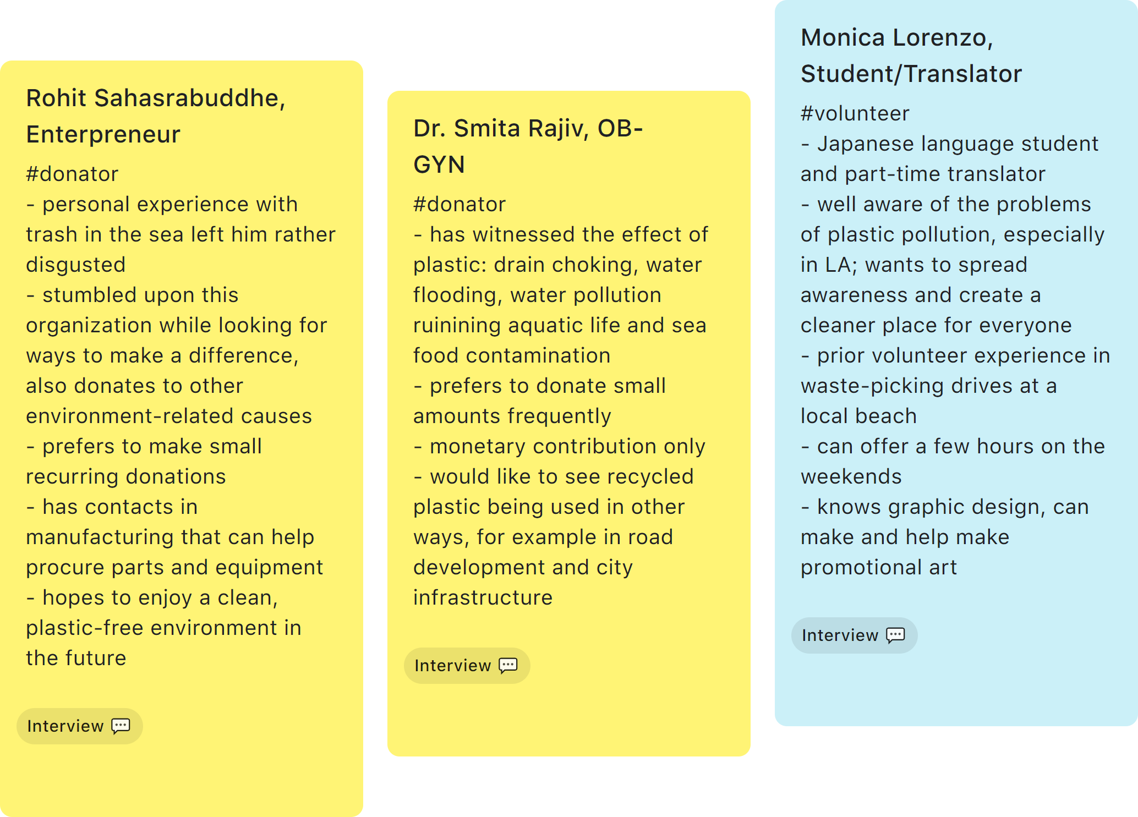
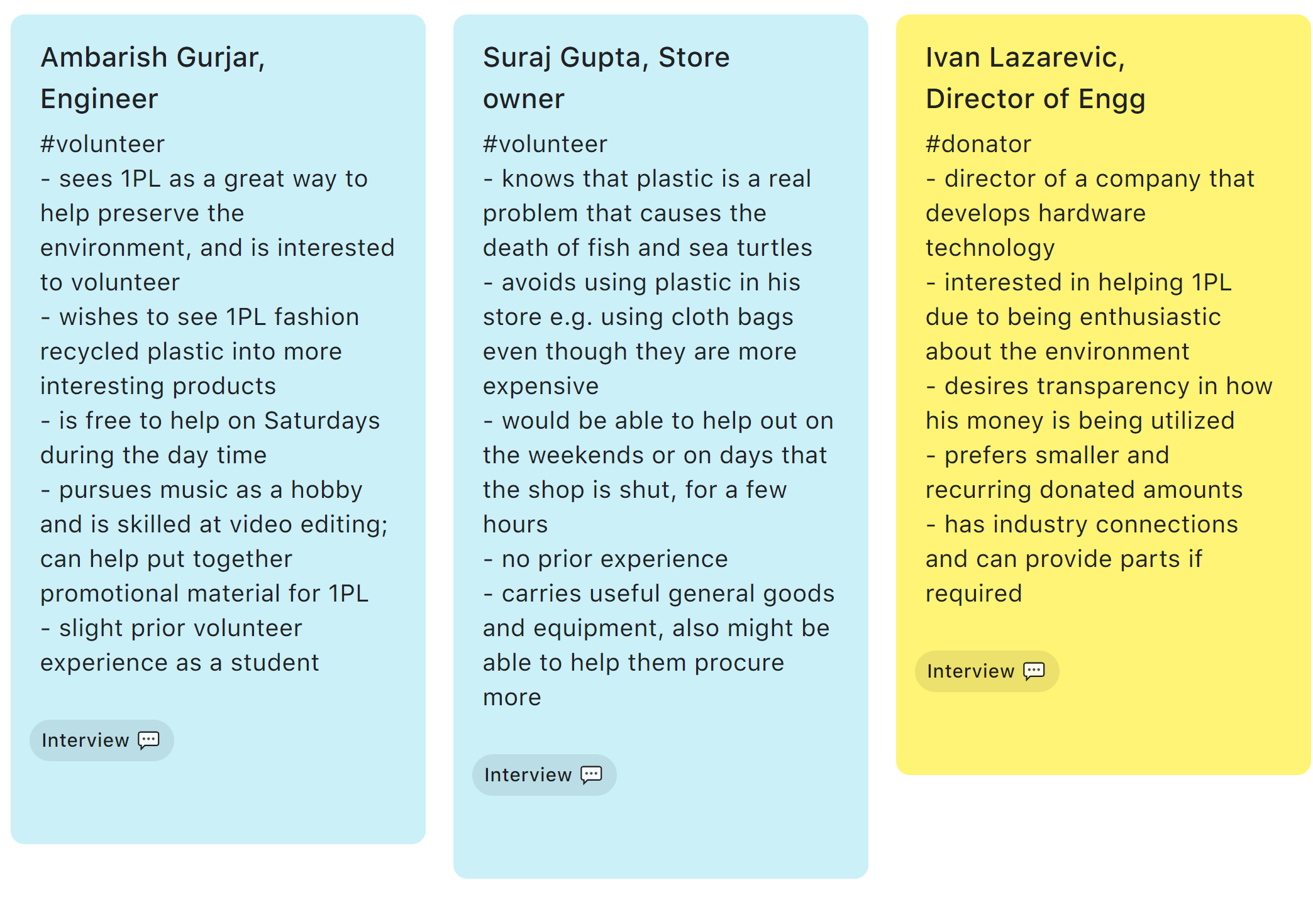
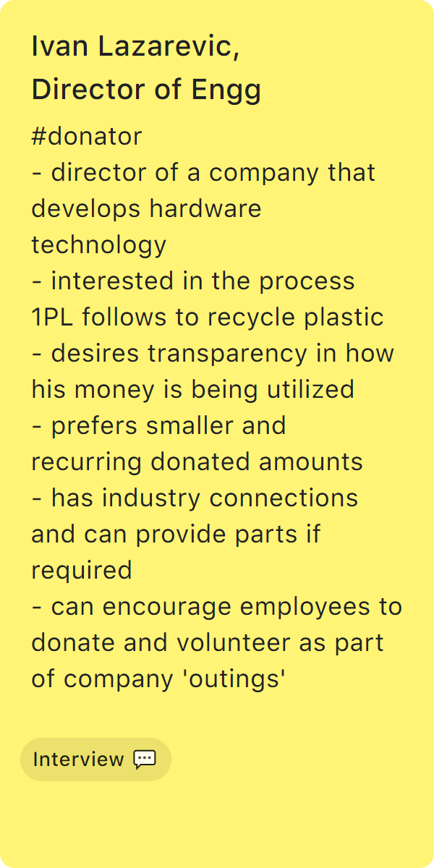
Proof of Data Collection
I use Google Keep on my phone to organize my notes.
13

Slide 14
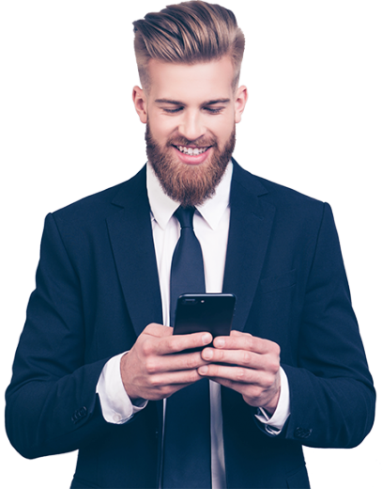
Goal-Directed Context User Scenario
Ivan is at his desk browsing the Internet on a leisurely Saturday afternoon as he gets a new email notification on his phone.
It’s the 1 Plastic Life newsletter with an update about their latest cleaning drive in Santa Monica beach.
He opens the link enclosed and discovers that they have added additional products to the online store, and notices a toy robot.
Knowing that this toy will also be a good way to discuss the topic of waste and recycling with his son, he purchases it, and also chooses to leave an additional amount as a donation to the cause.
Thinking that the recycled product will make an interesting topic of discussion, he shares its link to his Facebook, and gets back to his earlier task.
14

Slide 15

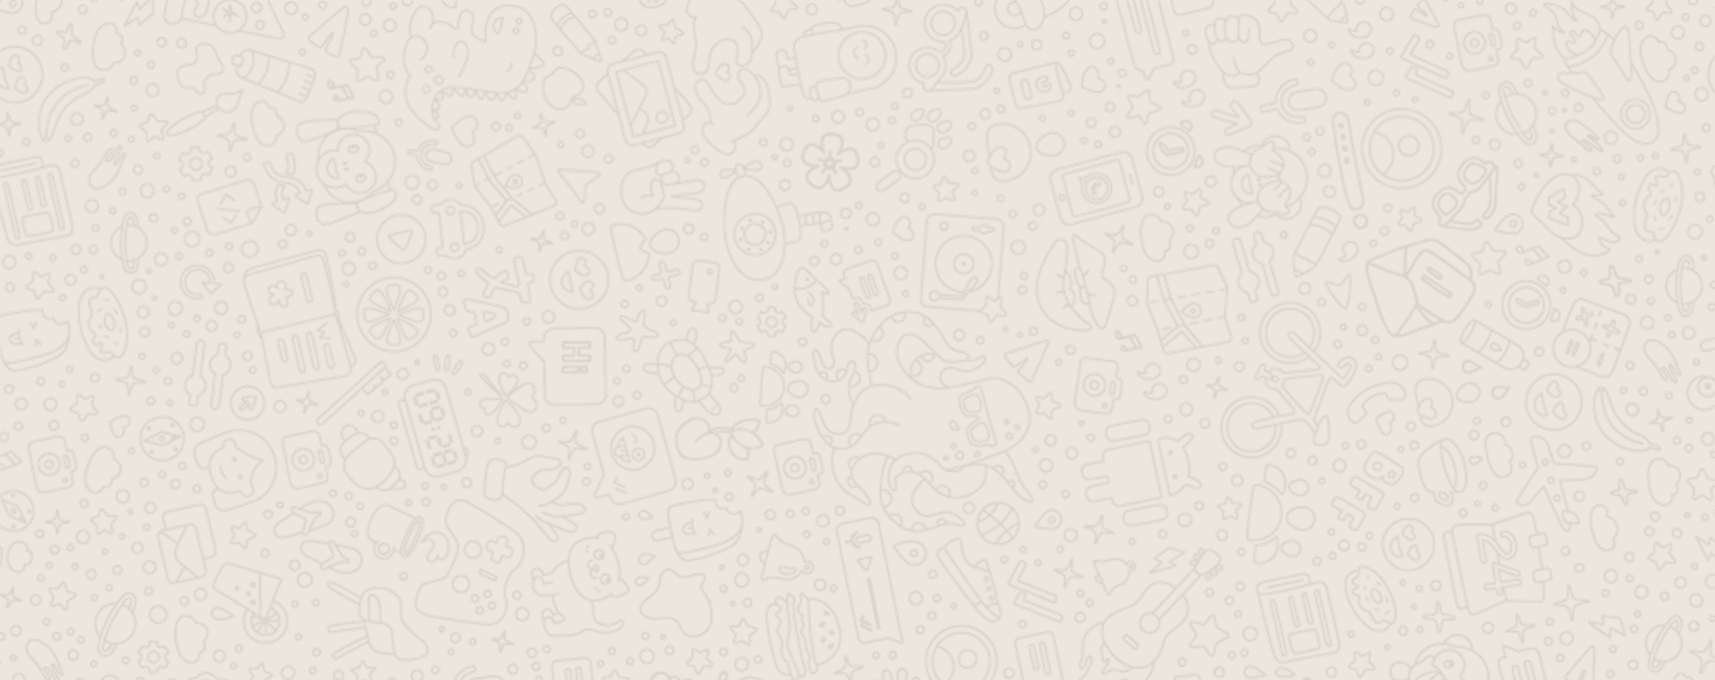
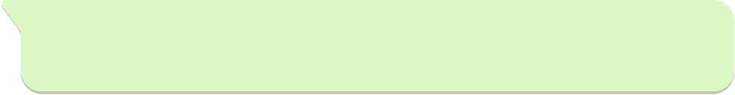
User Stories
As a nature lover, I want to enjoy a clean and thriving environment free of hazardous materials
As a philanthropist, I want to create or help create job opportunities for underprivileged individuals
As a proactive citizen, I want to learn how to reduce plastic pollution and help clean the city of plastic waste
As an engineer, I want to learn about and contribute to the development of new plastic recycling methods
As an environment-aware shopper, I want to purchase items made of recycled plastic
15

Slide 16
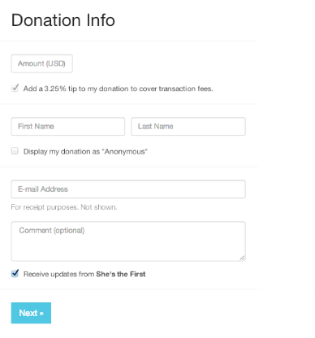
Use Case #1: Donate
Click on Donate in the site navigation
Select preset amount or enter custom donation amount
Select if donation is recurring, if yes, how often it is
Enter credentials: name, email and an optional message
Select a payment method and enter its details
Submit the form and obtain receipt
SAMPLE
16

Slide 17
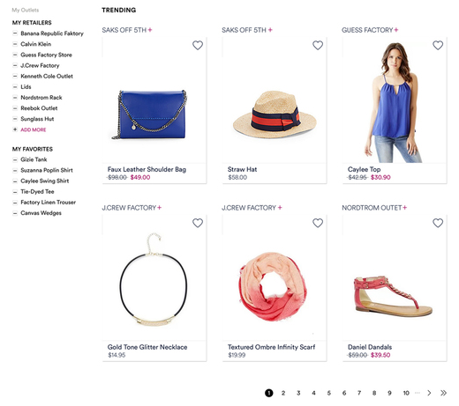
Use Case #2: Buy Recycled Products
Choose Shop in the site navigation
(Optional) Filter by category of item – e.g. toys, accessories, stationery
(Optional) Sort by criteria – e.g. date, price
Navigate list using pagination
Select an item to purchase
Input credentials: name and email
Select payment method
Optionally donate an amount
Finish payment and obtain receipt
SAMPLE
17

Slide 18
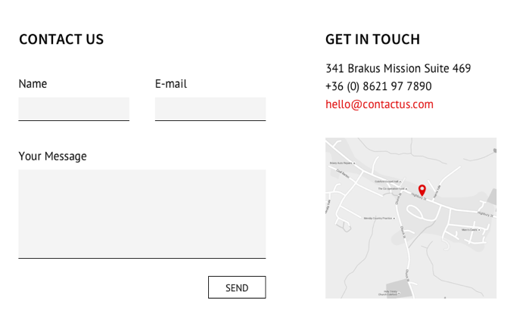
Use Case #3: Contact 1 Plastic Life
Click on Contact Us in the site navigation
Enter credentials: name and email
Enter the message to leave feedback
Check optional box to automatically subscribe to newsletter
Send the form
(Also note other contact methods including phone, email and links to social media)
SAMPLE
18

Slide 19

Feature List
Initial Draft
News feed
Blog posts
Social media widgets
Event calendar
Donate
Amount to donate
Option for recurring payment
Payment methods
Volunteer
Fill up application
Add attachments
Shop – buy recycled items
List catalog
Filter options – category
Sort options – released, price
Pagination
About Us – describes 1PL and their mission
Subscribe box – input email address for newsletter
Contact Us – phone, email and online form
19

